Slide 1
Assignment Instructions
Refer to the dataset provided on Canvas that lists 6 items sold in 22 transactions and complete the following activities. You can consider minimum support to be 50% and confidence of 0.7.
Calculate from the table:
The valid/frequent 3-itemset rules
All 4- and 5-itemsets rules, if any possible from the given data

Slide 2
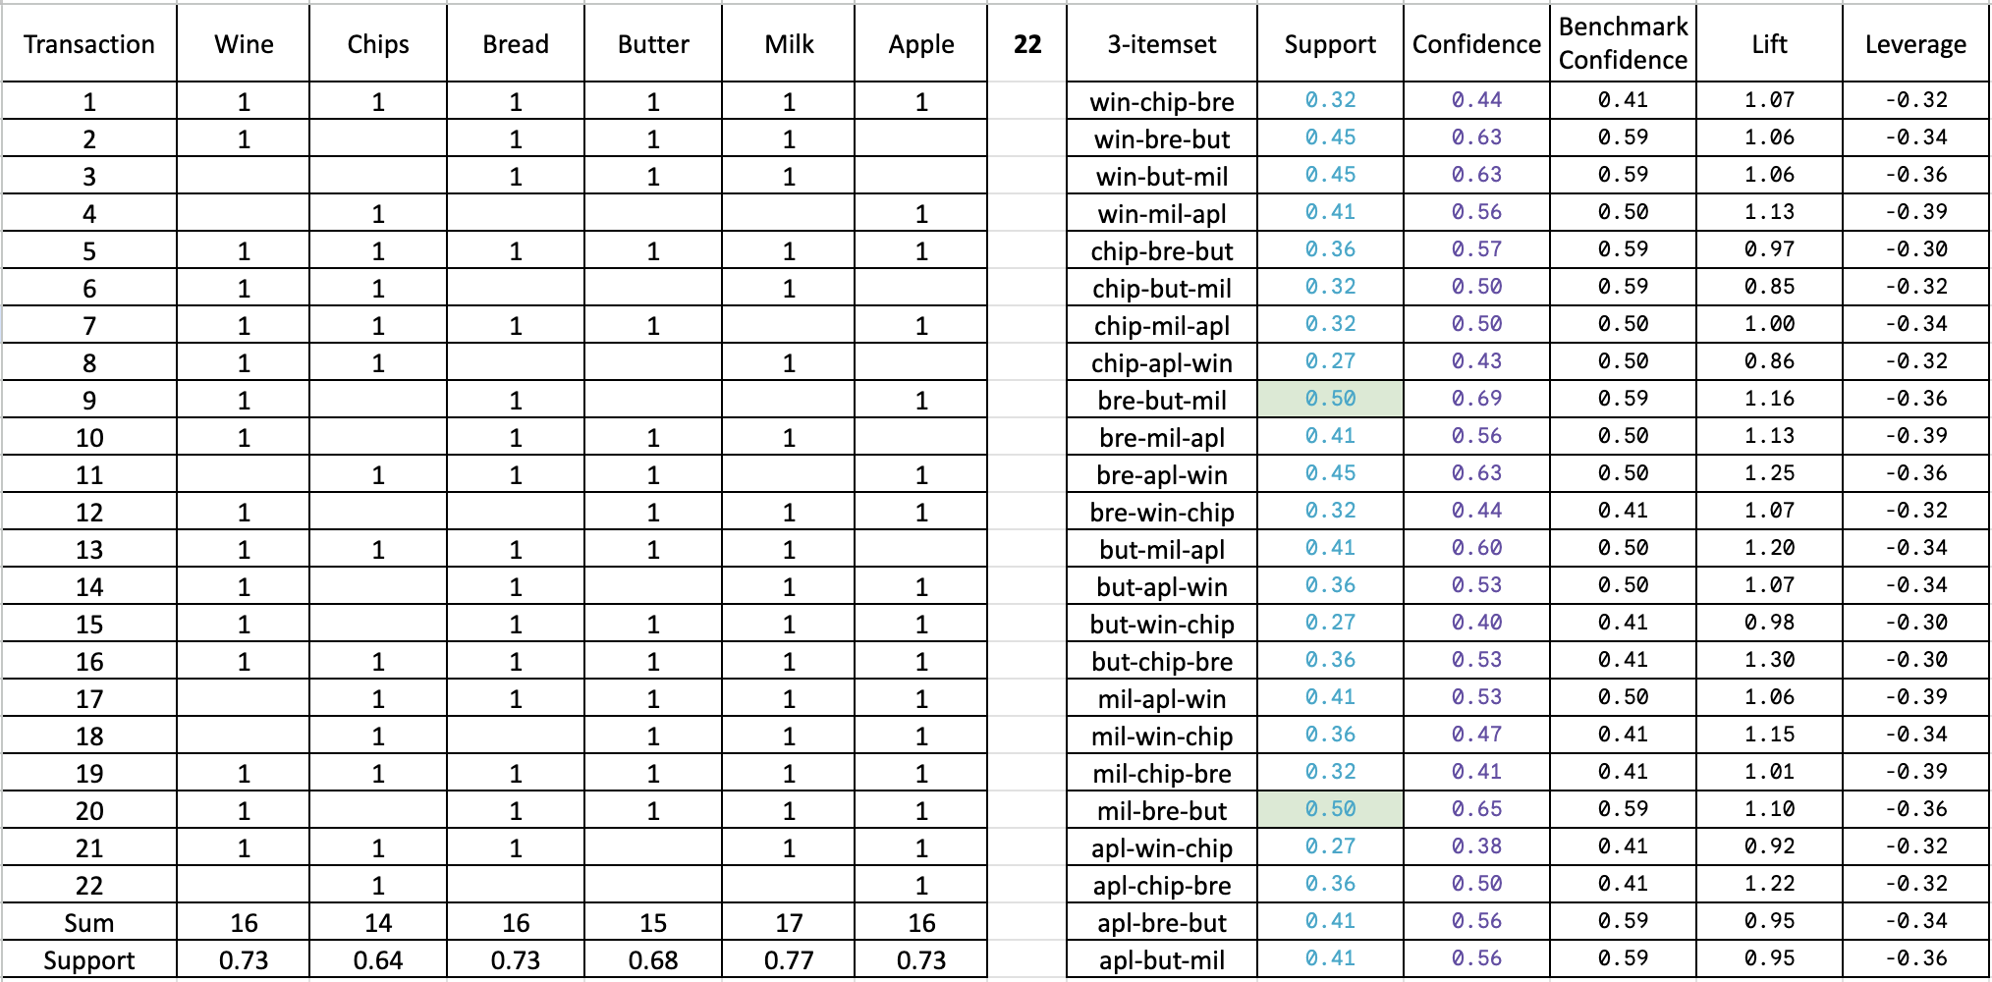
The valid/frequent 3-itemset rules
Only bread, butter, milk satisfies the support and reaches closer to the minimum confidence levels and the lift levels are also satisfactory. Therefore, this combination has better chances of co-occurance.

Slide 3
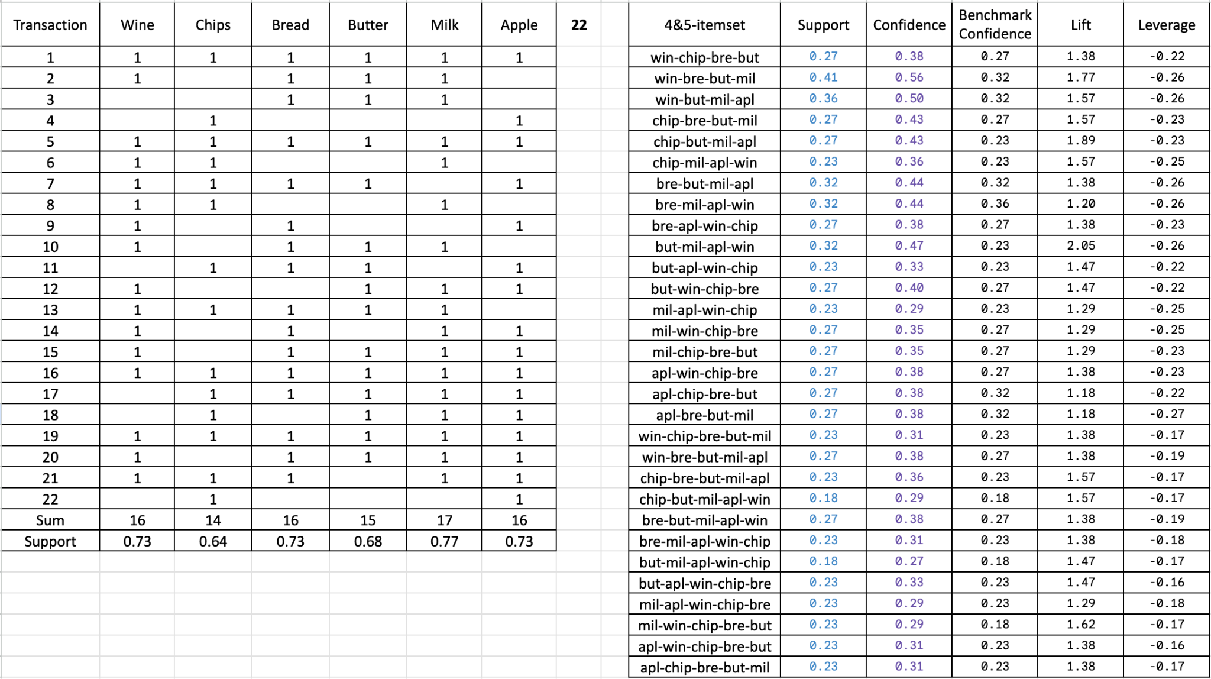
All 4- and 5-itemsets rules, if any possible from the given data
4 and 5 itemsets don’t satisfy the minimum support and confidence rules therefore, we cannot consider these itemsets to be placed as chances for co occurrence.

